Slide 1
Supervised & Unsupervised Learning for Volatility Prediction
By Moe Kyaw Thu, Lu Li, Joshua Marsh, Tam Truong & Saif Punjwani

Slide 2
Overview of the Presentation
Introduction and Data Exploration
Methodologies
Conclusion

Slide 3
Introduction and Data Exploration
Project Purpose: Aims to explore machine learning methods as an alternative to the conventional time-series models, notably GARCH, for volatility forecasting
Machine Learning Approach: Utilizes a combination of unsupervised and supervised models to predict volatility 10 minutes ahead
Principal Component Analysis
Convolutional Neural Networks
Random Forest
Ridge Regression
Kaggle's Optiver Realized Volatility Competition dataset:
6 months of historical time-series data for 126 stocks
13 features for each stock at 1-second increments
3 data files: book_train.parquet, trade_train.parquet & train_csv
Focuses on stock_id of 0 as a project
Notes:
Describe project
That being said, we use both supervised and unsupervised methods in our project: describe the methods
Describe the data structures

Slide 4
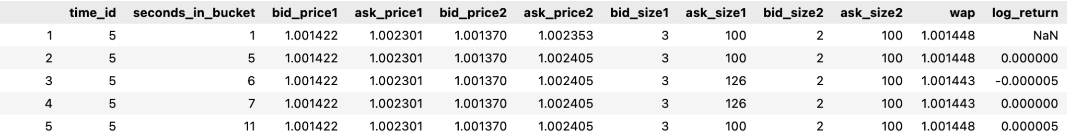
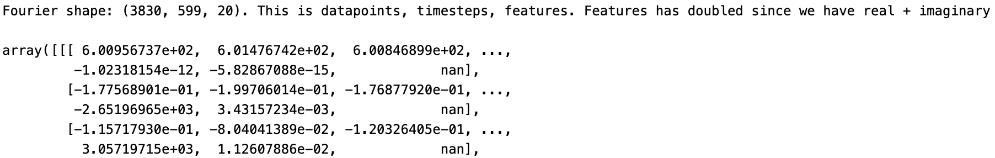
PCA
We use PCA in our project to generate features for volatility prediction
1. Fourier transform:
By applying PCA to the Fourier-transformed data, we can reduce its dimensionality while preserving its temporal invariance.
After applying Fourier transform to the full_book dataset, we can the matrix shown below. Then we standardized our training data set and splitted this Fourier time series into training set (the first 80%) and test set (the last 20%).
Now the data is ready for the PCA model

Slide 5
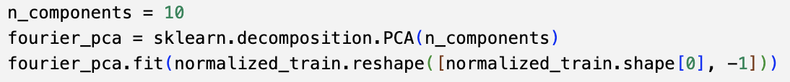
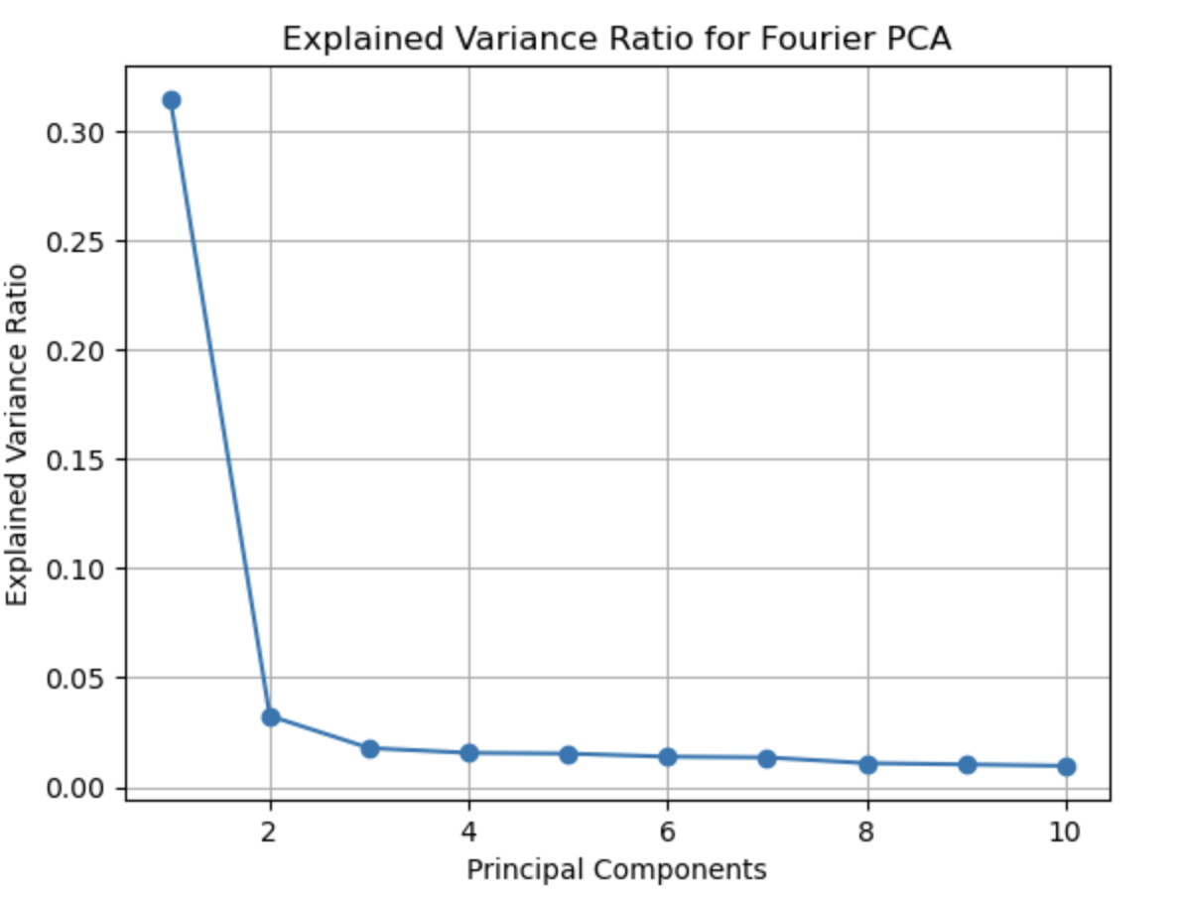
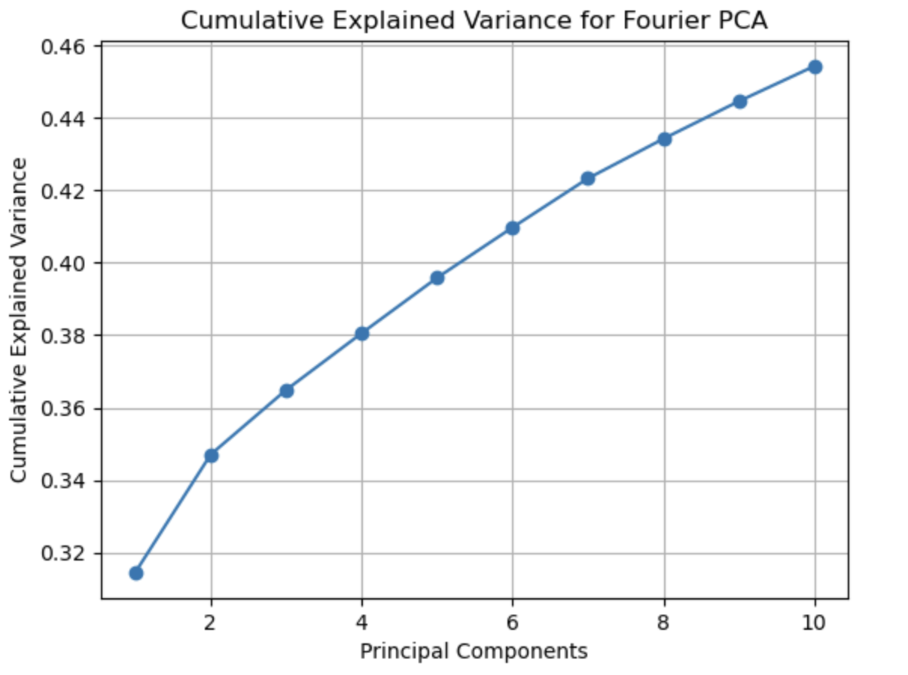
2. PCA using sklearn (part 1)

Slide 6
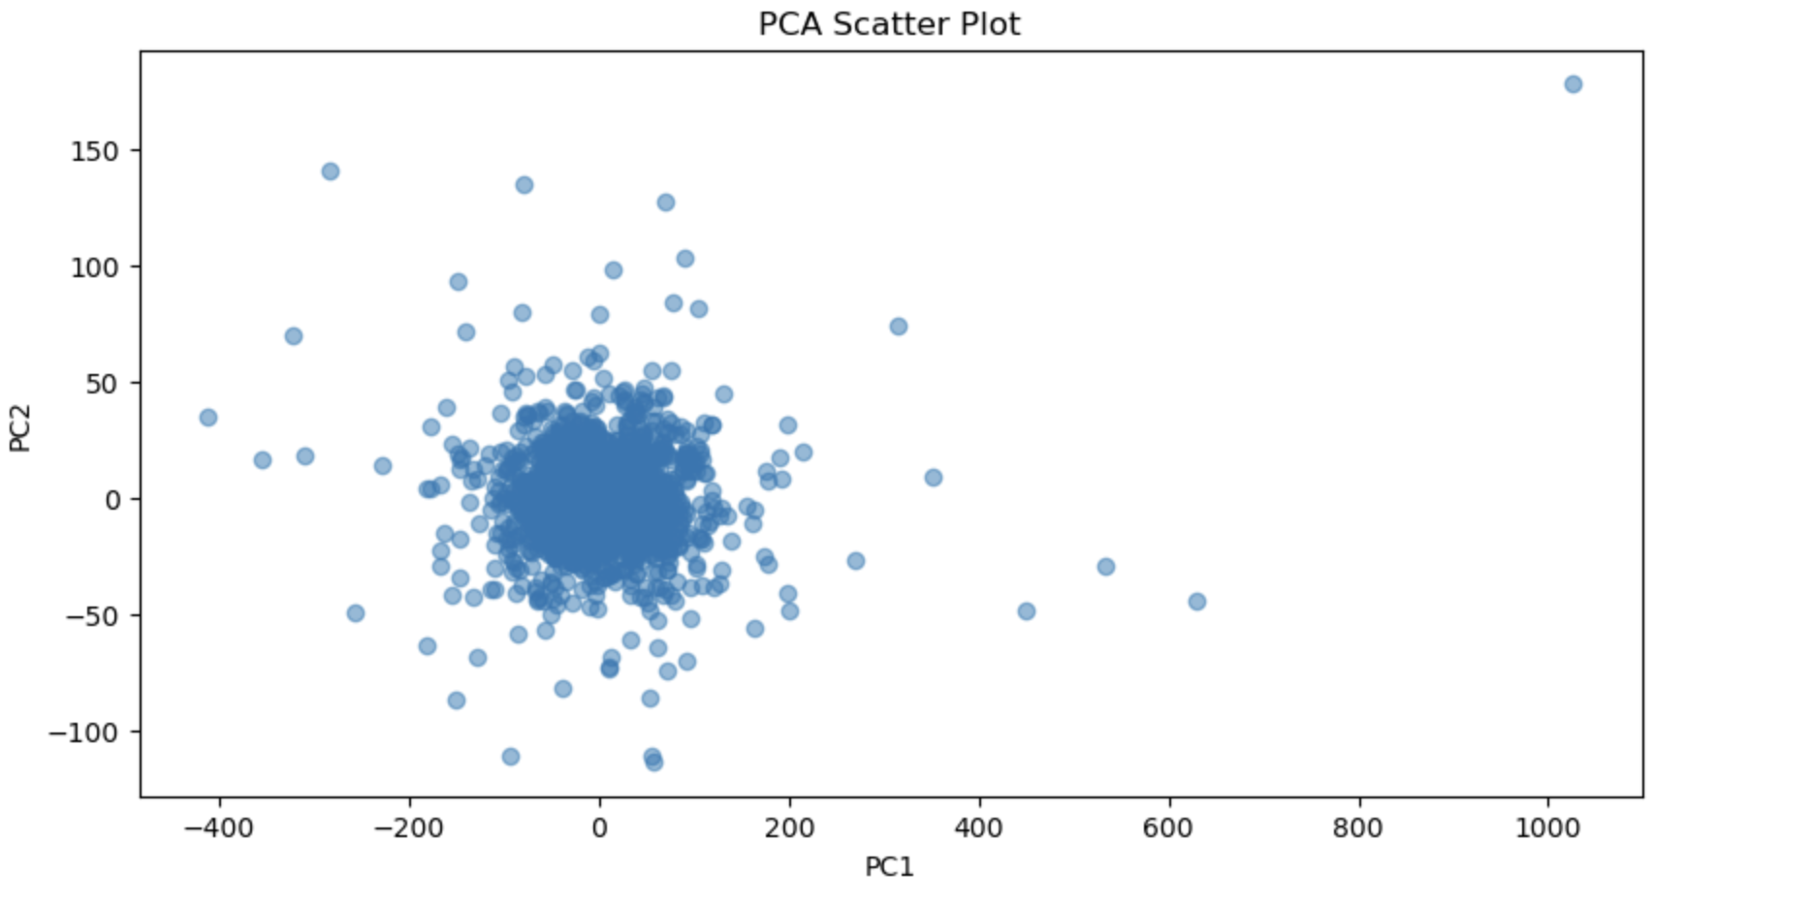
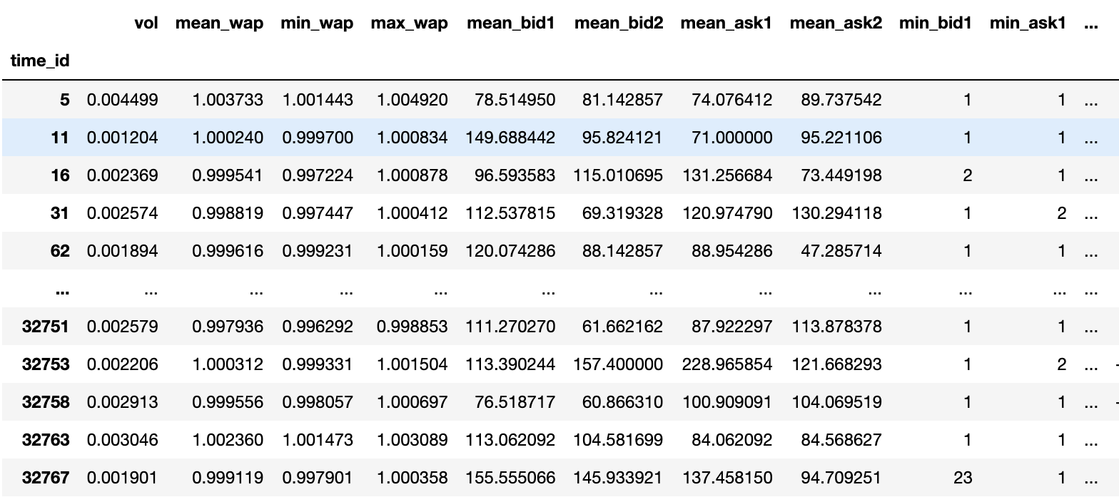
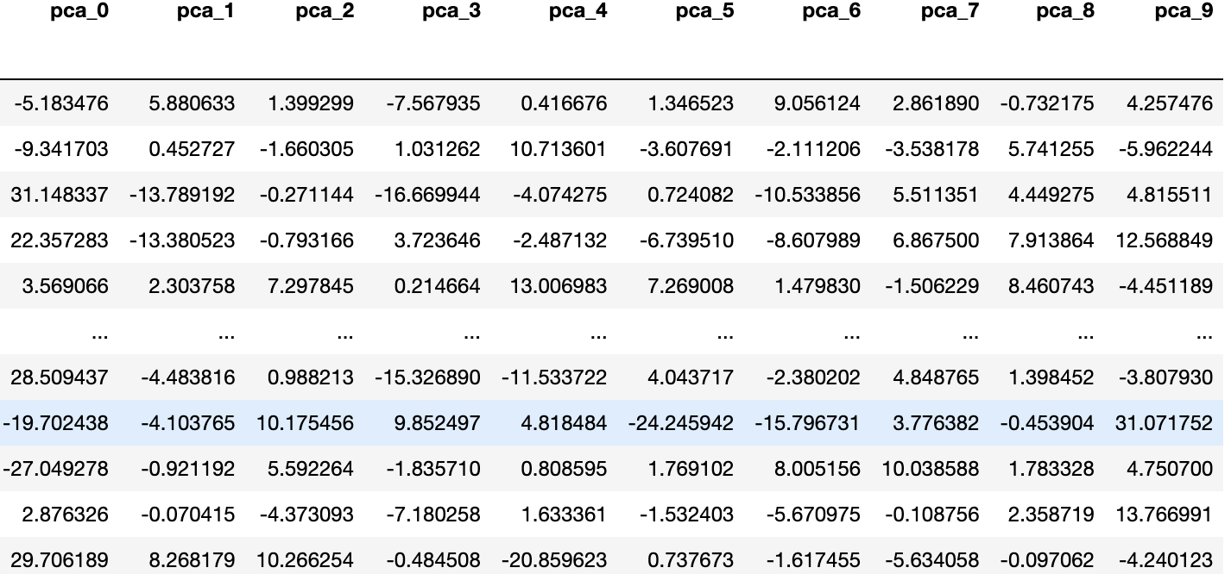
2. PCA using sklearn (part2)

Slide 7
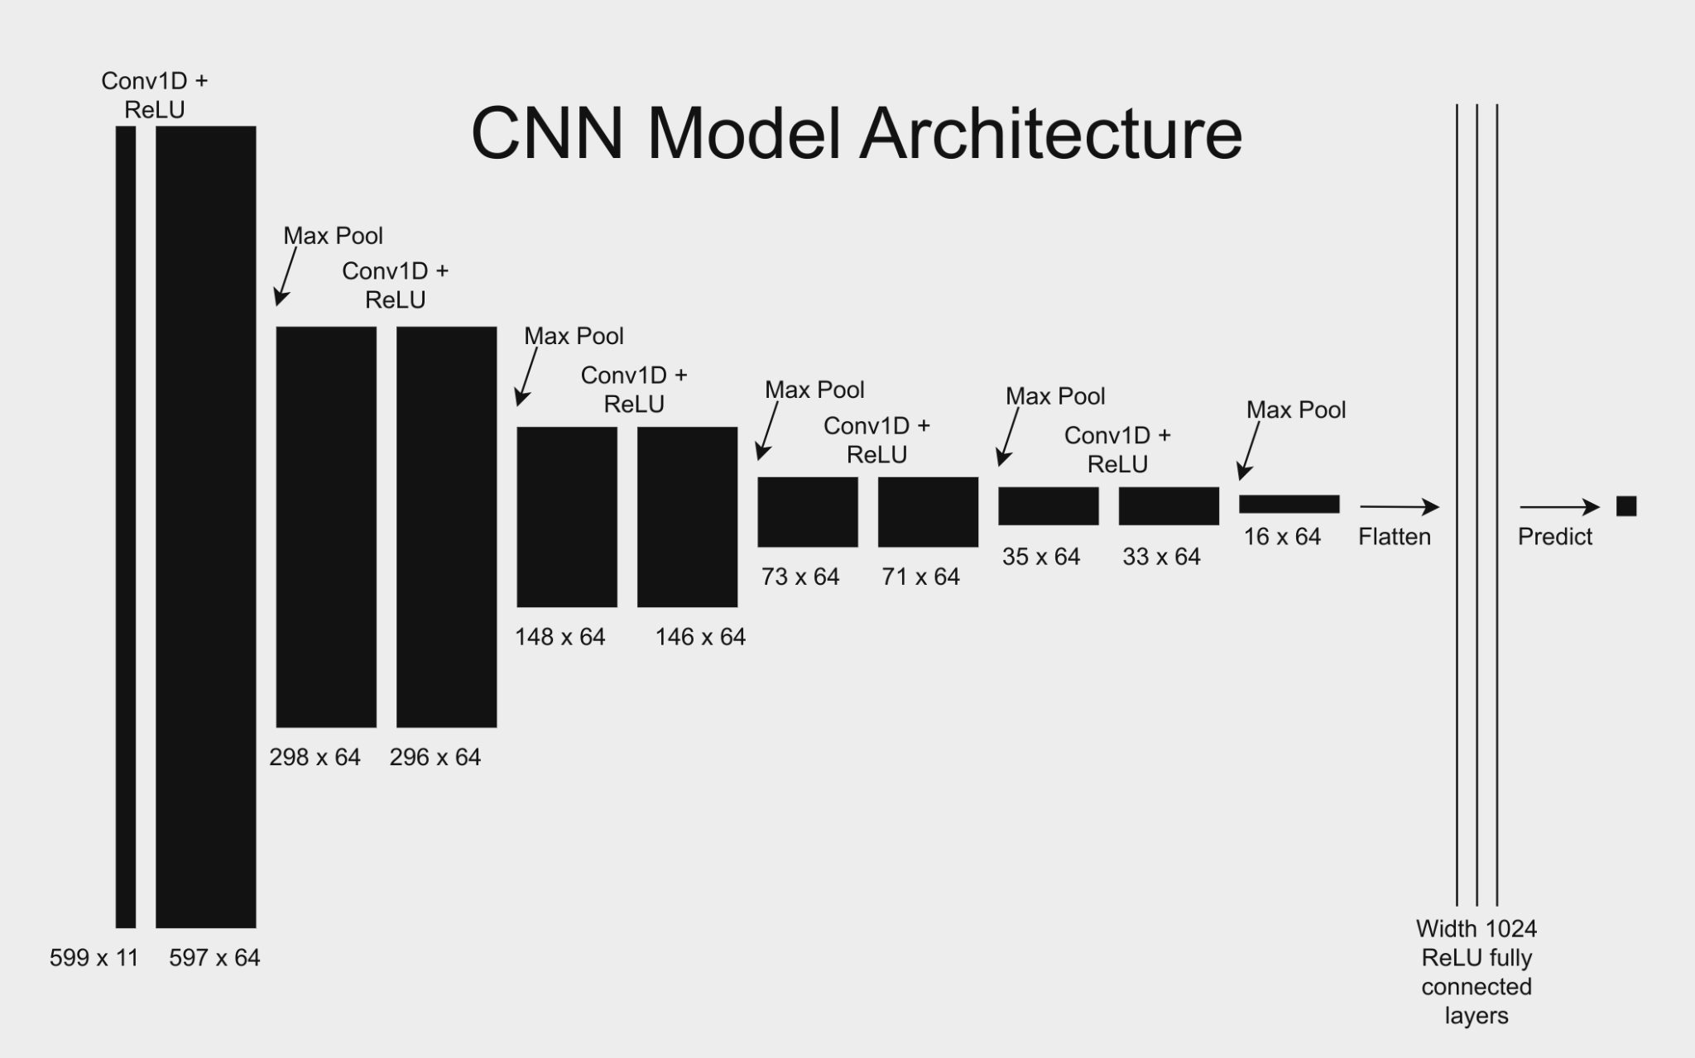
Convolutional Neural Network
Since the data is time-series, a 1-dimensional CNN is appropriate. A sequence of convolutions and max-pool layers gradually flattens the data, before it is sufficiently flat to be fed into a fully connected layer.

Slide 8
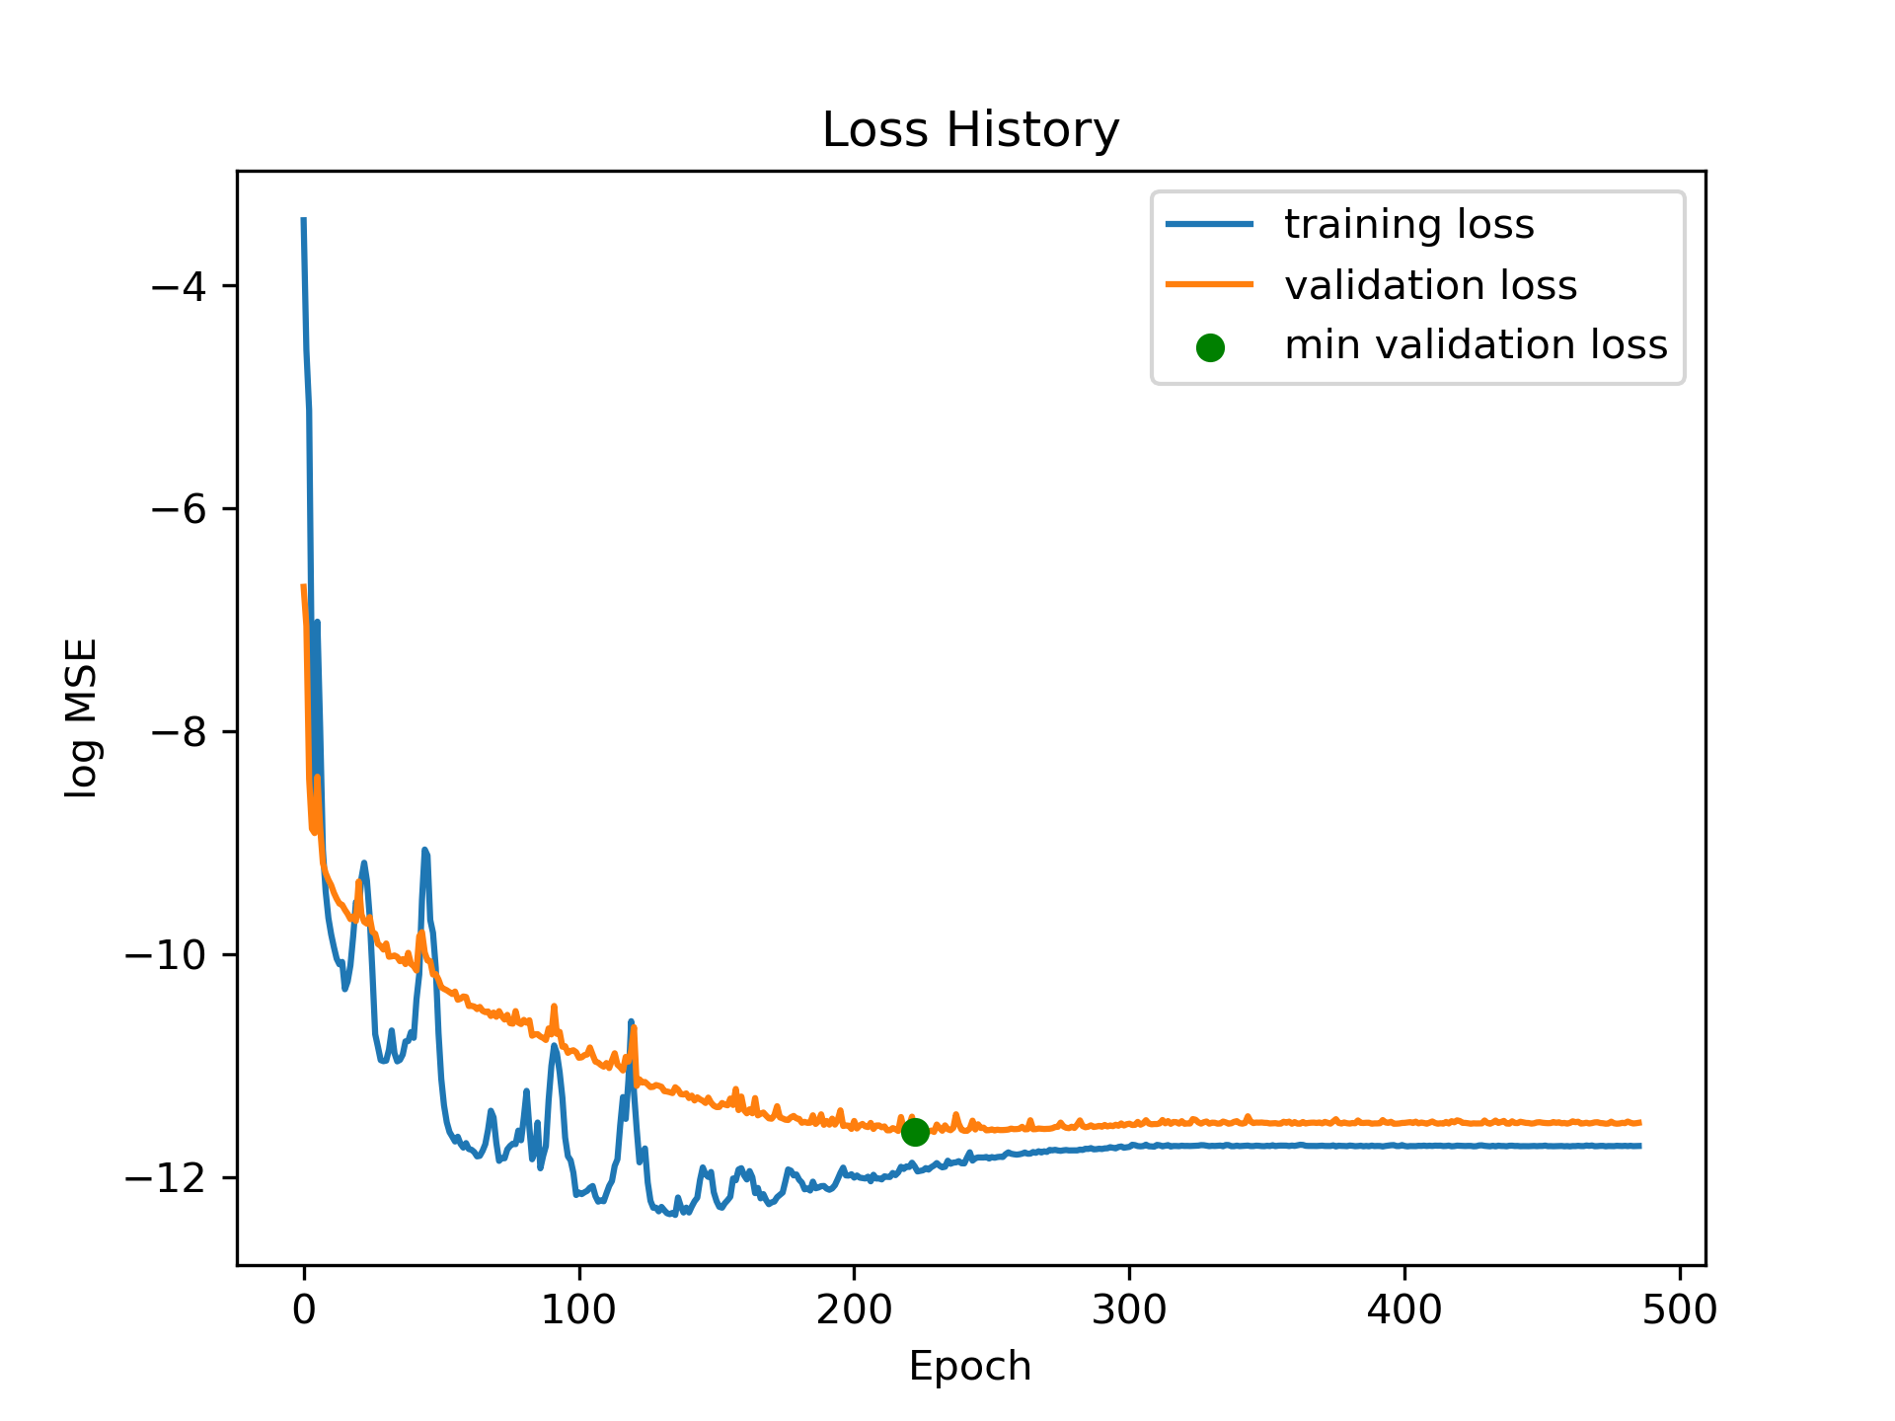
CNN Training and Results
To prevent overfitting, weight decay/L2 regularization was used. A portion of the training data was withheld to use as validation data. We used early stopping to prevent overfitting, and used the validation data to identify when to stop.
RMSE: 0.00253
MAE: 0.00182
R-squared: -0.000137 (poor)

Slide 9
Random Forest Results
For the Random Forest model, we used the GridSearchCV class to perform an exhaustive search over specified parameter values for an estimator. We found the best parameters to be {‘max_depth’: 20, ‘min_samples_split’: 2, ‘n_estimators’: 200}. Below are the identified RMSE and MAE. R-squared is also included to show the goodness of fit of the model.
RMSE: 0.00134
MAE: 0.00901
R-squared: 0.718

Slide 10
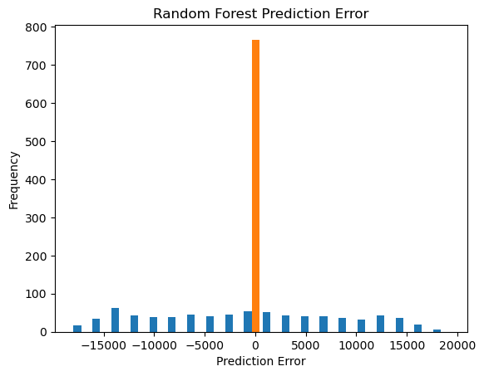
Random Forest Graph
The graph shows the prediction error for the Random Forest. The error is close to ‘0,’ which means that it is small, meaning good results.

Slide 11
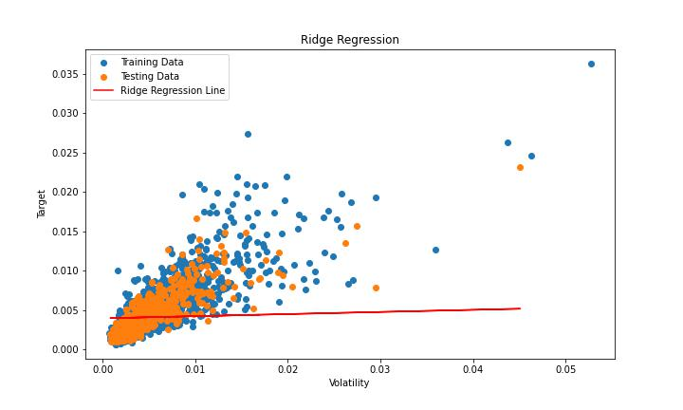
Ridge Regression Results
Using GridSearchCV
BestAlpha: 0.0001
Feature: Volatility
Target: Target Data
RMSE: 0.00155
R-squared: 0.678
Notes:
Another model that we are using to test our data to compare with other models are ridge regression. First we were using Grid Search to find the best Alpha, a feature that we picked from our feature data set is volatility. After running the ridge regression on the training data, our testing data results in a really low Root Mean Squared Error which is good and a 0.678 r-squared. Going to the next slide

Slide 12
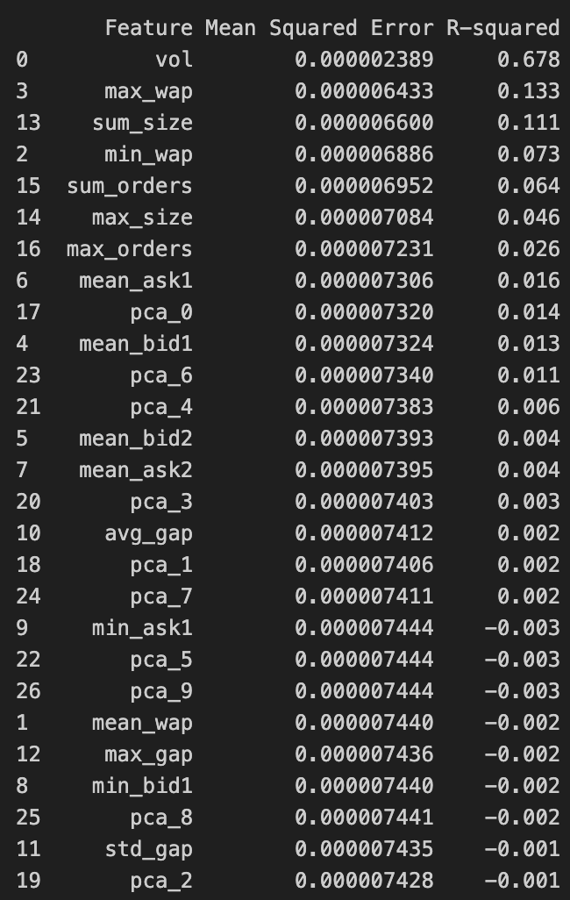
Ridge Regression Table
R-squared = 1.0: The model perfectly predicts the target variable (unrealistics)
R-squared = 0.0: The model does not perform better than a simple mean of the target values.
R-squared < 0.0: The model is worse than a simple mean, not suitable at all!
Notes:
The table on the right contains every feature we have, sorting in a descending order based on the R-squared value, we can see that feature volatility is closest to 1 and other features that are closer to 0 suggests that the model does not perform better than just a simple mean of the target values.

Slide 13
Conclusion
Demonstrates the volatility of forecasting using a variety of supervised and unsupervised methods
Demonstrates that ML methods are reliable:
E.g. combination of Fourier and PCA methods enables the detection of shift-invariant patterns while reducing dimensionality
Additionally, RF performs the best based on the outcomes
Demonstrates the use of ML methods to enhance the robustness in finance-related predictions

